Slide 1


Margin Protection Program for Dairy Producers:
Ideas on Mitigating Financial Risk
Cameron Thraen and Christopher Wolf
The Ohio State University, Michigan State University
Special thanks to Dianne Shoemaker for the use of a few slides and the author of 15 Measures of Dairy Farm Competitiveness. You can find a copy of the useful document at:
Notes:
Opening slide: remove the Draft: Not for Release statement when we have completed the slide set.

Slide 2

Who is the National Program on Dairy Markets and Policy
A voluntary association of Land Grant agricultural economists who share an interest in the economics of dairy markets and policy and who are committed to provide educational and research materials to assist policy-makers and dairy industry decision-makers.
Marin Bozic
University of Minnesota
Brian Gould
University of Wisconsin
John Newton
University of Illinois
Charles Nicholson
The Pennsylvania State University
Andrew Novakovic
Cornell University
Mark Stephenson
University of Wisconsin
Cameron Thraen
The Ohio State University
Christopher Wolf
Michigan State University
Notes:
Use this only when this presentation is a stand alone and this information has not been introduced.

Slide 3
What is the MPP-Dairy Producer Decision Education Project?
Funded by USDA Farm Service Agency, as authorized by the Agricultural Act of 2014
For the purpose of developing a decision tool for dairy farmers and complementary educational programs
Conducted under a university consortium led by the University of Illinois and referred to as the National Coalition for Producer Education.
Notes:
Use only when the presentation is stand alone and not already introduced.

Slide 4
Presentation Outline
(How to think about my operations need for MMP)
Assessing the likelihood and potential impact of adverse events
  Double Whammy
    Low milk prices & high feed prices (2009 event)
  Single Whammy
    High feed prices (2012 event)

Slide 5
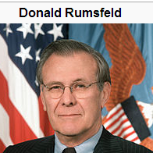
Presentation Outline
(How to think about my operations need for MMP)
Assessing the likelihood and potential impact of adverse events
  Rumsfeld Whammy: The Unknown Unknowns ?
Using MPP to develop contingency plans to deal with UU events !

Slide 6
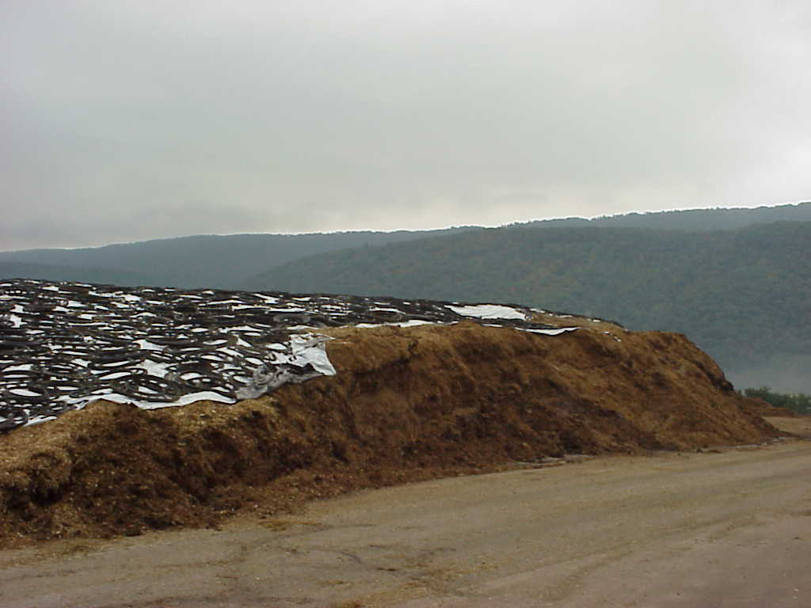
How do you know if your farm is at risk?
Milking lots of cows?
High rolling herd average?
Big, new, 4WD truck?
Bounder parked in drive?
The right tractors?
Big bunker silos?
Robots?

Slide 7
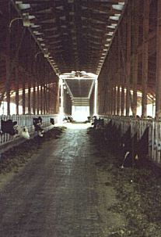
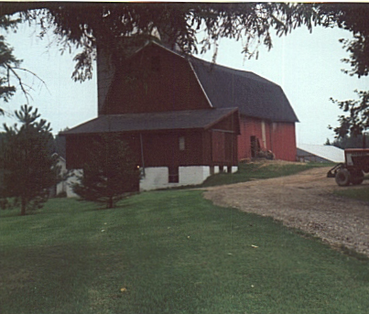
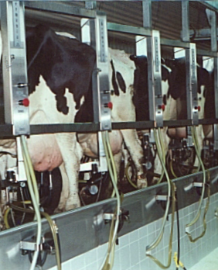
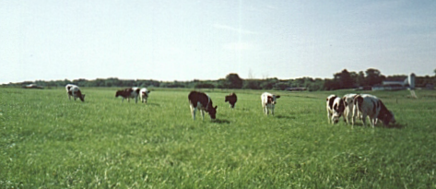
Different Farms…
...Different Risk
...Different Plan
Notes:
We want to look at two questions here today:
What is your farm’s cost of production?
What is a good milk price for you?
-each farm’s price is influenced by quality, quantity, over-order premiums and buyer
-You can’t tell by looking
-Different farms will have different costs of production
-Different farms will have different “good” milk prices
-It is okay to be different!

Slide 8
Calculating Milk to Feed Margins
Correlated with profit on dairy farms
  Milk is largest source of revenue and feed is largest expense
Use historic information on milk prices and feed purchases plus homegrown feed
3-5 years information is preferred
  Recent years include highs (2011) and lows (2009, 2012)

Slide 9
Examples of dairy operation’s IOFC
 | Milk cows | Milk prod. | Milk price | Milk revenue | Feed cost | IOFC | IOFC margin
 | Head | cwt | $/cwt | $ | $/cwt | $ | $/cwt
Leaders Dairy | 161 | 37,004 | 20.03 | 741,190 | 517,316 | 223,874 | 6.05
Legends Dairy | 324 | 82,766 | 20.23 | 1,674,356 | 1,160,379 | 513,977 | 6.21

Slide 10
Relationship to ADPM to Dairy Farm Record IOFC Margin
(annual basis)
$/cwt

Slide 11
Key Measures to monitor:
Where do I Start ?
Your Dairy’s Financial Balance Sheet

Slide 12
Determining Risk Exposure from Unanticipated Low Margins
Step 1: Calculate the amount of loss your operation can withstand
Step 2: Evaluate the magnitude of the loss and impact on farm liquidity and solvency
Balance Sheet information is required

Slide 13
Potential decrease in
IOFC margin from 2013 level
Potential reduction in IOFC from anticipated IOFC
 | Actual 2013 | 20% reduction | 40% reduction | 60% reduction | 80% reduction
 |  |  | $’s
Leaders Dairy | 223,874 | 44,775 | 89,550 | 134,324 | 179,099
Legends Dairy | 513,977 | 102,795 | 205,591 | 308,386 | 411,182
Those darn Unknown Unknowns
The 2009 event was close to the 60% reduction for a typical dairy farm

Slide 14
Leaders Dairy Balance Sheet, January 1, 2014
Assets |  |  | Liabilities
Current | $ |  | Current | $
Total Current Assets | 164,291 |  | Total Current Liabilities | 158,684
Noncurrent |  |  | Noncurrent Liabilities | 483,451
Total Noncurrent Assets | 1,929,514
Total Farm Assets | 2,093,805 |  | Total Farm Liabilities | 642,135
 |  |  | Total Farm Equity | 1,451,670
Current Ratio | 1.04 |  | Debt-to-Asset Ratio | 0.31
Notes:
Chris: This slide and the next one like it. We need to discuss how we can use this information. The table is too large to display and number too small. Perhaps just a table showing the headings for a typical balance sheet without the numbers and then use the numbers in later calculations. I am open to suggestions.

Slide 15
Legends Dairy Balance Sheet January 1, 2014
Assets |  |  | Liabilities
Current | $ |  | Current | $
Total Current Assets | 548,996 |  | Total Current Liabilities | 260,890
Noncurrent |  |  | Noncurrent Liabilities | 2,456,782
 | 51,579
Total Noncurrent Assets | 4,424,483
Total Farm Assets | 4,973,479 |  | Total Farm Liabilities | 2,717,672
 |  |  | Total Farm Equity | 2,255,807
Current Ratio | 2.10 |  | Debt-to-Asset Ratio | 0.55

Slide 16
Dairy 2013 six pack
Current Ratio
  Working capital
    Current Assets
    Current Liabilities
Debt/asset ratio
  Assets & Liabilities
Debt per cow
Debt repayment schedule
Cost of production
Net Farm Income per cow

Slide 17
Key Measures of Financial Strength
Liquidity: the ability of a business to meet its cash financial obligations as they come due
  Measured using Current Ratio
Solvency : the degree to which the liabilities of a business are backed up by assets
  Measured using Debt-to-Asset Ratio

Slide 18
Liquidity: Working Capital
Calculation of working capital:
Current Assets
minus Current Liabilities
Current Ratio

Slide 19
Liquidity: Working Capital
Average WC values and % of total expenses:
2012 NY Business Summary: Small Herds <120
  All herds (34) 19% $ 54,369
  Top 50% 17% $ 57,685
2012 NY Business Summary: Large Herds >300
  All herds (108) 22% $ 1,031,281
  Top 20% 30% $ 1,512,945
2012 NY Business Summary: All Herds
  All herds (169) 22% $ 693,585
  Top 10% 30% $ 1,376,812
Notes:
Can we get this information for the Legends and Leaders? This can be used in the Syracuse program.

Slide 20
Current Ratio = (Current Farm Assets) (Current Farm Liabilities)
Guideline:
<1 Poor --- 1 to 2 (fair) --- >2.0 (good)
- Indicates the ability to liquidate current assets to cover current liabilities without impacting adversely on the farm’s ongoing operations

Slide 21
Liquidity: Current Ratio
Average CR values and % of total expenses:
2012 NY Business Summary: Small Herds <120
  All herds (34) 2.05
  Top 50% 1.91
2012 NY Business Summary: Large Herds >300
  All herds (108) 2.52
  Top 20% 3.06
2012 NY Business Summary: All Herds >300
  All herds (169) 2.50
  Top 10% 3.25
Notes:
Can we get this information for the Legends and Leaders? This can be used in the Syracuse program.

Slide 22
Solvency: Debt to Asset Ratio
Measures the ability of the business to meet all debt obligations
    At a point in time
    If all assets are sold
Varies over the life of the business
    New business
    Expanding business
    Pre-retirement business

Slide 23
Debt to Asset Ratio
Competitive level:
≤ 40 percent

Slide 24
Debt to Asset Ratio
Calculation:
(Total farm debts
÷ total farm assets)
x 100
An Example:
$ 850,000 debt
÷ 2,500,000 assets
= 0.34
x 100_________
= 34% D/A ratio

Slide 25
Can your Debt to Asset ratio be too high or too low ?
Too high:
  Why?
    Stage of business
    Too much debt
  Check Other measures
    Current ratio
    Debt repayment
    Profitability
Too low:
  Why?
    Rent vs. own
  Check Other measures
    Net farm income
    Profitability
    Need more investment for profit?

Slide 26
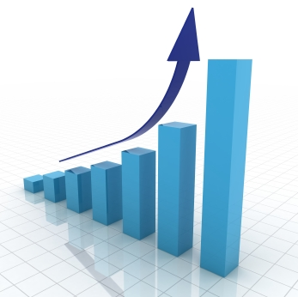
Debt to Asset Ratio (D/A)
= (Total Farm Liabilities)
(Total Farm Assets)
Guideline: higher value is considered an indicator of greater financial risk
Over +0.60 (poor)
Between 0.40-0.60 (fair)
Under +0.40(good)
- D/A tells you the share of business assets owed to creditors
D/A
Good Poor

Slide 27
Solvency: Debt/Asset
Average DA values :
2012 NY Business Summary: Small Herds <120
  All herds (34) +0.23
  Top 50% +0.26
2012 NY Business Summary: Large Herds >300
  All herds (108) +0.32
  Top 20% +0.26
2012 NY Business Summary: All Herds
  All herds (169) +0.31
  Top 10% +0.29
Notes:
Can we get this information for the Legends and Leaders? This can be used in the Syracuse program. I will also get this data for 2009 event.

Slide 28
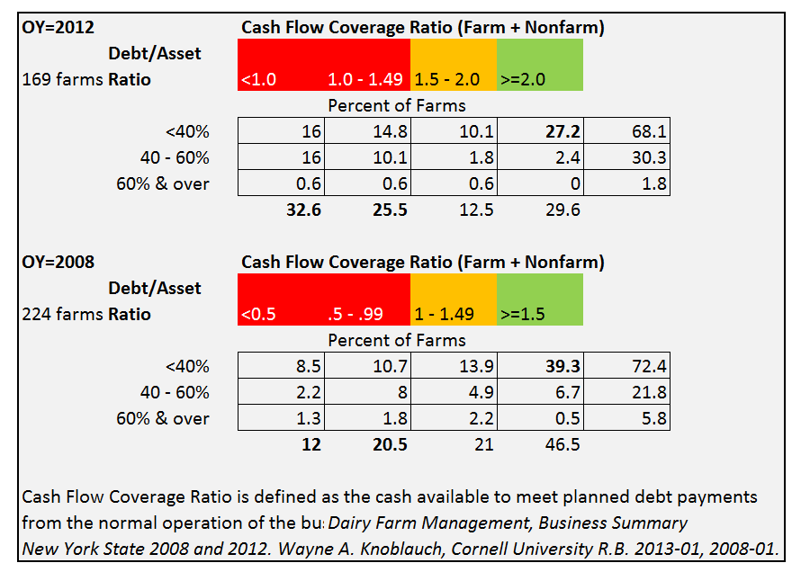
Debt/Asset & Cash Flow
  An adequate D/A ratio does not necessarily mean your business has the ability to meet cash flow obligations
Notes:
Can we get this information for the Legends and Leaders? This can be used in the Syracuse program. I will also get this data for 2009 event.

Slide 29
How do you handle poor margins?
Liquidity is used first.
  Cash reserves are tapped.
Equity can be used to acquire operating loans.
  Current assets are sold
Selling intermediate or long-term assets has lasting consequences for the operation.

Slide 30
How can MPP Protect
Farm Financial Assets?
The anticipation is that the MPP margin will correlate with actual farm margins.
Farmers can use past farm records to assess the relevance and use of MPP margin.
Set coverage level based on needs to maintain liquidity and solvency.

Slide 31
Identify your Financial Tolerance for Risk
$8.00
Less MPP PH Coverage at a higher Coverage Level
Greater MPP PH Coverage at a Lower Coverage Level
Coverage Level
$6.00
$4.00
25%
60%
90%
Coverage Quantity

Slide 32
Select a combination of CL and C% that your checkbook can accommodate
6m # PH
MPP cost rises dramatically above $6.50 and nearing 90% CL

Slide 33
How Inadequate of a Margin can your Operation Withstand?
Know your farm’s key financial measures.
Are they at strong target levels ?
    CR above a target level
    Above 2.0
    DA below some target
    Perhaps 0.4 or 0.6
Understand the impact that a low margin will have on these key measures of financial strength.

Slide 34
Conclusions
Farms with larger amounts of financial risk must pay more attention to risk management.
Use financial statements to assess your farm’s risk position.
Decide whether or not the MPP can be an important part of managing financial risk.

Slide 35
Margin Protection Program for Dairy Producers:
Ideas on Mitigating Financial Risk
Cameron Thraen and Christopher Wolf
The Ohio State University, Michigan State University
Special thanks to Dianne Shoemaker for the use of a few slides and the author of 15 Measures of Dairy Farm Competitiveness. You can find a copy of the useful document at:

